Slide 1
3 - vehicle_safety_final (Impute - undersampled categorised)

Slide 2
See 3 - vehicle_safety_final (Impute - undersampled categorised) in Genie for bins
Removed
ID
VE_ORIGAVTW
VE_WHEELBAS
Sample

Slide 3
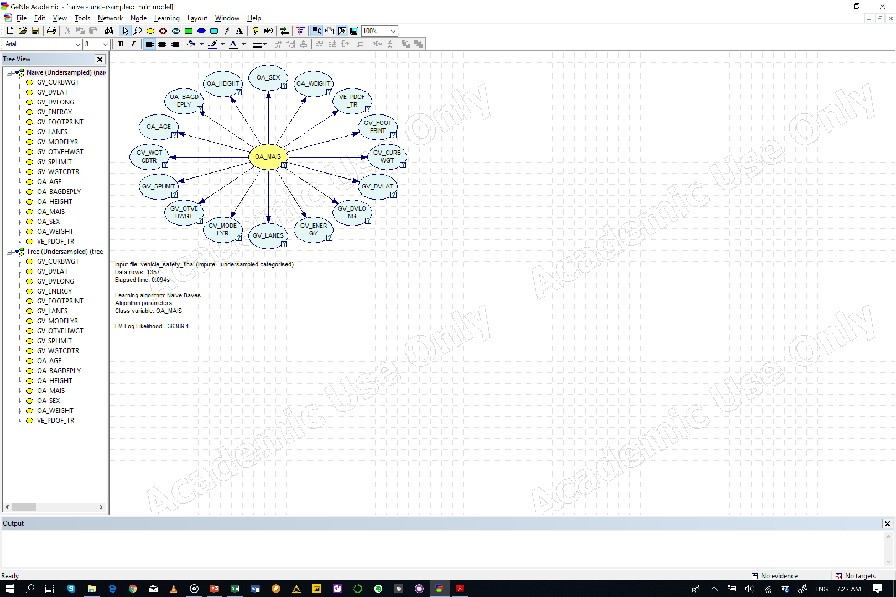
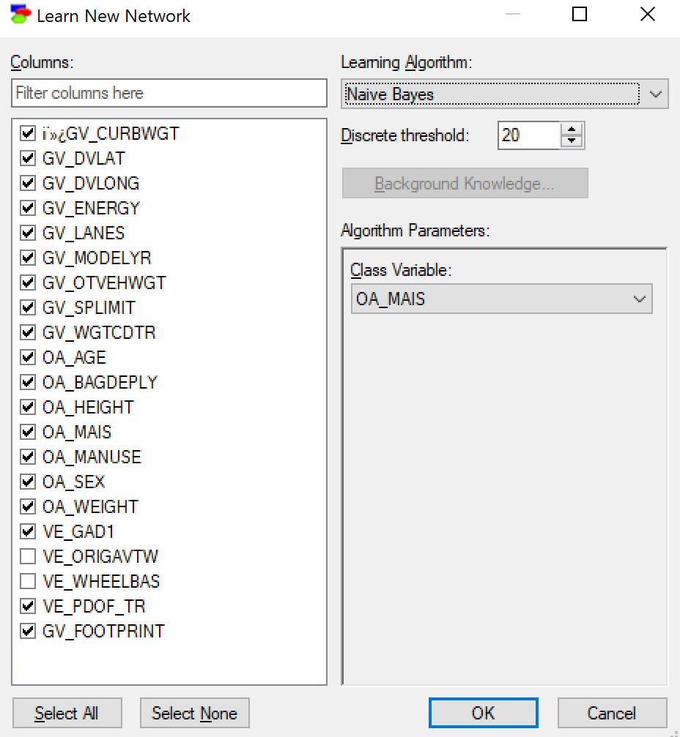
Naïve Bayes

Slide 4
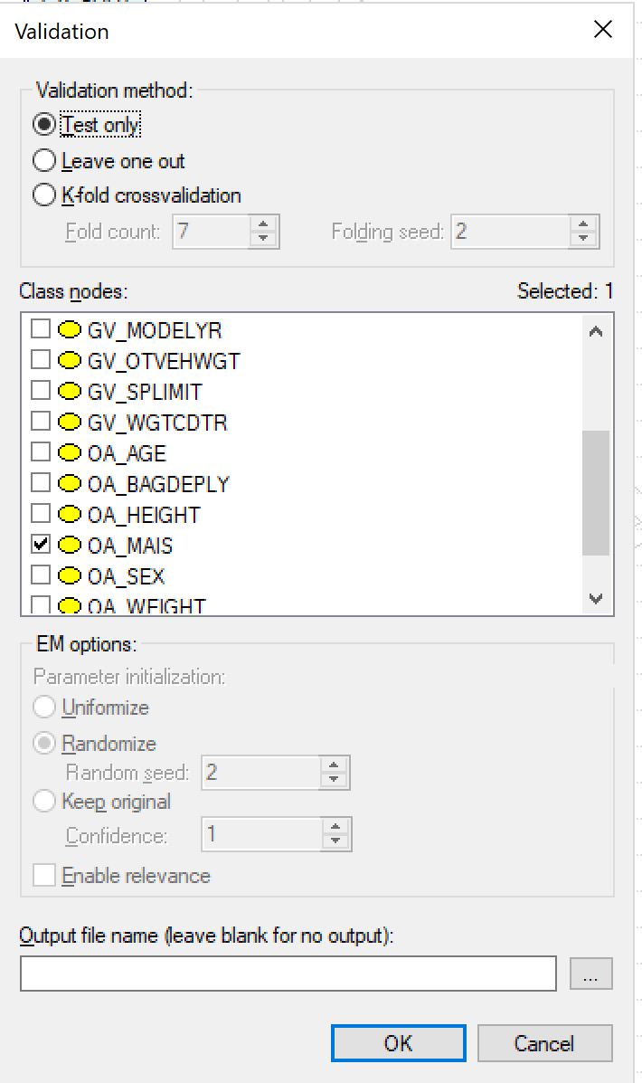
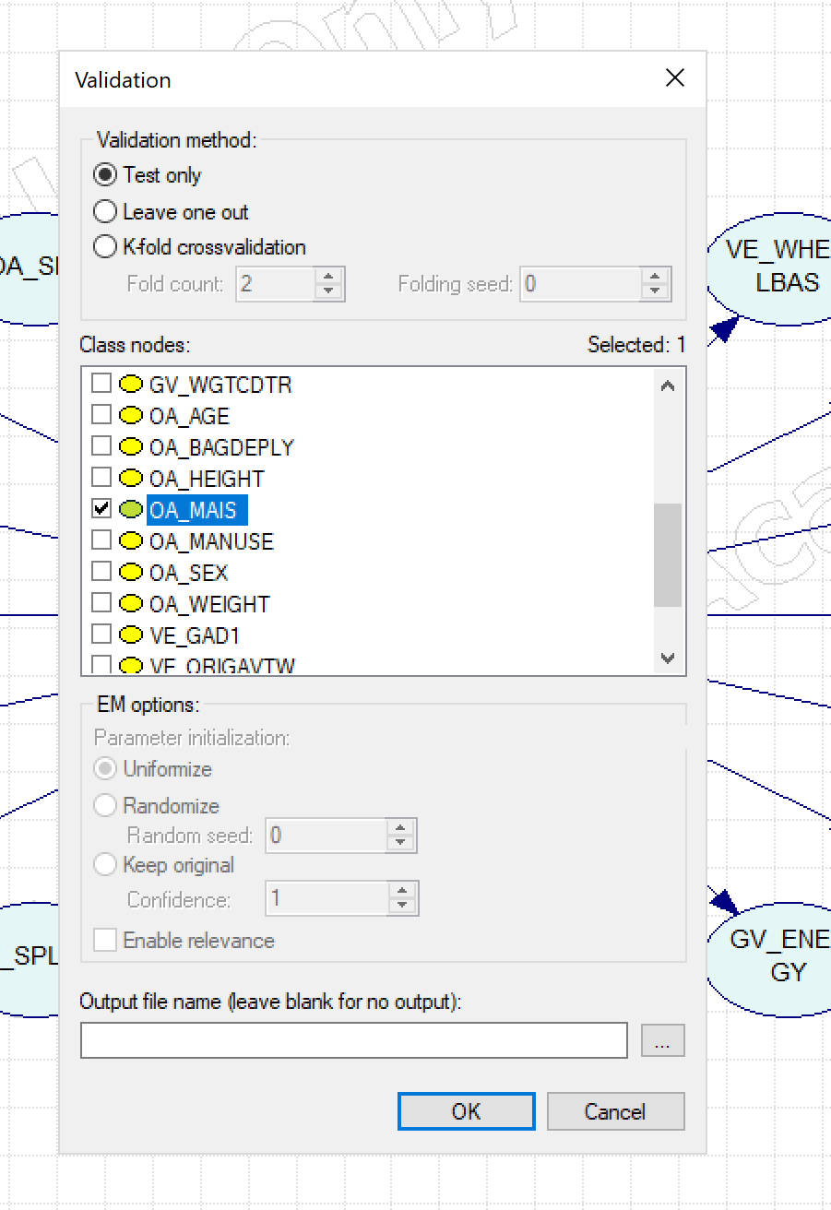
Test
Default
Naïve Bayes
Accuracy
OA_MAIS = 0.426676 (579/1357)
State0 = 0.676768 (134/198)
State1 = 0.373134 (75/201)
State2 = 0.391705 (85/217)
State3 = 0.331933 (79/238)
State4 = 0.41791 (84/201)
State5 = 0.37788 (82/217)
State6 = 0.470588 (40/85)
 |  | Predicted
 |  | State0 | State1 | State2 | State3 | State4 | State5 | State6
Actual | State0 | 134 | 33 | 17 | 9 | 4 | 1 | 0
 | State1 | 58 | 75 | 37 | 14 | 12 | 4 | 1
 | State2 | 35 | 30 | 85 | 31 | 21 | 8 | 7
 | State3 | 20 | 28 | 41 | 79 | 36 | 19 | 15
 | State4 | 12 | 19 | 17 | 23 | 84 | 30 | 16
 | State5 | 6 | 15 | 17 | 24 | 41 | 82 | 32
 | State6 | 2 | 2 | 1 | 10 | 12 | 18 | 40

Slide 5
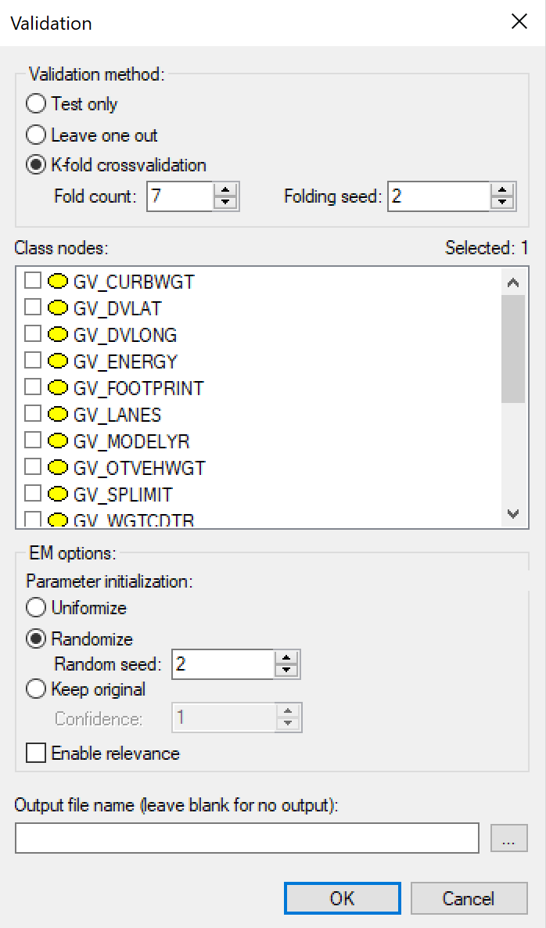
Test
K-fold
Naïve Bayes
Accuracy
OA_MAIS = 0.302874 (411/1357)
State0 = 0.510101 (101/198)
State1 = 0.273632 (55/201)
State2 = 0.267281 (58/217)
State3 = 0.273109 (65/238)
State4 = 0.263682 (53/201)
State5 = 0.262673 (57/217)
State6 = 0.258824 (22/85)
 |  | Predicted
 |  | State0 | State1 | State2 | State3 | State4 | State5 | State6
Actual | State0 | 101 | 62 | 15 | 12 | 6 | 1 | 1
 | State1 | 73 | 55 | 33 | 18 | 9 | 12 | 1
 | State2 | 37 | 34 | 58 | 51 | 21 | 11 | 5
 | State3 | 14 | 31 | 45 | 65 | 39 | 29 | 15
 | State4 | 10 | 19 | 25 | 31 | 53 | 45 | 18
 | State5 | 6 | 15 | 17 | 31 | 54 | 57 | 37
 | State6 | 2 | 3 | 1 | 14 | 17 | 26 | 22

Slide 6
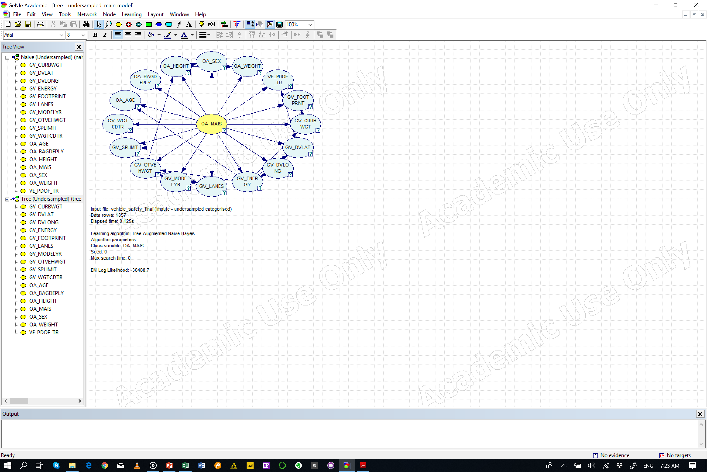
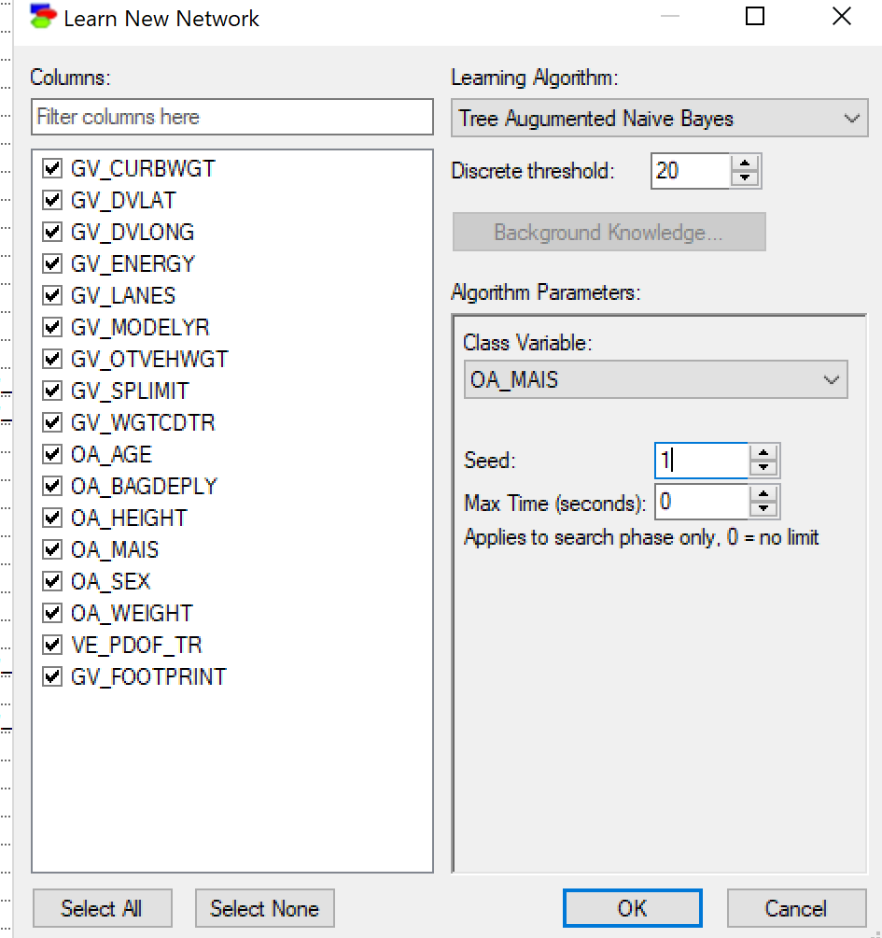
Tree Augmented Bayesian Networks

Slide 7
Test
Default
Tree Augmented Bayes
Accuracy
OA_MAIS = 0.831245 (1128/1357)
State0 = 0.863636 (171/198)
State1 = 0.80597 (162/201)
State2 = 0.820276 (178/217)
State3 = 0.806723 (192/238)
State4 = 0.870647 (175/201)
State5 = 0.788018 (171/217)
State6 = 0.929412 (79/85)
 |  | Predicted
 |  | State0 | State1 | State2 | State3 | State4 | State5 | State6
Actual | State0 | 171 | 13 | 9 | 4 | 0 | 1 | 0
 | State1 | 15 | 162 | 7 | 10 | 6 | 1 | 0
 | State2 | 7 | 12 | 178 | 13 | 3 | 4 | 0
 | State3 | 5 | 10 | 16 | 192 | 5 | 10 | 0
 | State4 | 2 | 4 | 5 | 10 | 175 | 5 | 0
 | State5 | 3 | 4 | 4 | 16 | 11 | 171 | 8
 | State6 | 0 | 1 | 0 | 0 | 3 | 2 | 79

Slide 8
Test
K-fold
Tree Augmented Bayes
Accuracy
OA_MAIS = 0.428887 (582/1357)
State0 = 0.525253 (104/198)
State1 = 0.442786 (89/201)
State2 = 0.317972 (69/217)
State3 = 0.407563 (97/238)
State4 = 0.447761 (90/201)
State5 = 0.474654 (103/217)
State6 = 0.352941 (30/85)
 |  | Predicted
 |  | State0 | State1 | State2 | State3 | State4 | State5 | State6
Actual | State0 | 104 | 39 | 29 | 9 | 8 | 9 | 0
 | State1 | 35 | 89 | 36 | 23 | 9 | 7 | 2
 | State2 | 23 | 36 | 69 | 45 | 19 | 22 | 3
 | State3 | 12 | 26 | 45 | 97 | 29 | 21 | 8
 | State4 | 7 | 11 | 22 | 33 | 90 | 28 | 10
 | State5 | 5 | 13 | 10 | 33 | 34 | 103 | 19
 | State6 | 1 | 2 | 3 | 4 | 18 | 27 | 30

